Slide 1


Using the Globus Software Development Kit
Brian Roland
Data Management Specialist
Northwestern IT
Research Computing and Data Services

Slide 2
The Challenge of Manual Data Management
In today's research landscape, scientific workflows often involve the movement of large datasets between various storage locations. Manually managing these data transfers can present a variety of challenges:
Time-consuming file transfers
Error-prone processes
Difficulty in tracking transfers and task progress
Limitations when integrating data movement into complex workflows

Slide 3
Globus Automation to the rescue!
Globus offers automation options that can be leveraged to help address the challenges of data management. You can improve the efficiency of your research workflows by leveraging the Globus Software Development Kit (SDK) for integrating Globus capabilities into your own applications.
Automating data transfers minimizes manual intervention, reduces errors, and ensures data movement happens seamlessly within your scientific pipelines, allowing you to focus on the core aspects of your research.

Slide 4
Review: What is Globus
Globus is a data transfer and sharing tool that enables secure, reliable, and high-performance data transfer and management for research and academic institutions across endpoints they call Collections.
Globus provides data movement across different storage systems, facilitates data sharing, and allows users to automate workflows with minimal manual intervention.
Globus is widely adopted by universities, national labs, and research centers for its ability to handle large-scale data efficiently.

Slide 5
Review: Globus Collections and Endpoints
A collection in Globus represents a data storage location that can be accessed and managed through the platform. There are several types of collections:
Personal Endpoint: Created using Globus Connect Personal, allowing individuals to transfer data from their local machines.
Mapped Collection: Uses institutional authentication mechanisms for access control.
Guest Collection: Enables controlled data sharing with specific users without requiring them to have direct system access.

Slide 6
Review: Northwestern Mapped Collections
Name | UUID
Northwestern Quest | d5990400-6d04-11e5-ba46-22000b92c6ec
Northwestern Quest RDSS | 8f796c9e-f5c8-11e5-9842-22000b9da45e
Northwestern AWS us-east-1 N. Virginia | bf0474ea-df2f-45f6-82e3-41d062d84ce7
Northwestern AWS us-east-2 Ohio | a14148f0-23dc-488f-affd-bd981f919b10
Northwestern AWS us-west-2 Oregon | 880cd765-5d14-43f6-97a6-2dbb355f3560
Northwestern OneDrive Pilot* | 930c2fcb-416e-4540-a757-496f86acbe70
* Does not allow Guest Collections

Slide 7
What is the Globus SDK?
The Globus SDK is a Python-based library that provides programmatic access to Globus services.
It allows developers and researchers to build automated data transfer scripts, manage user permissions, and integrate Globus functionalities into their existing applications.
The SDK simplifies complex workflows, making it easier to move and share large datasets programmatically.

Slide 8
Benefits of Using the Globus SDK
Utilizing the Globus SDK offers several advantages:
Automation: Reduces manual effort in managing data transfers and sharing.
Scalability: Efficiently handles large-scale and high-performance data movements.
Security: Leverages OAuth2 authentication for secure access to resources.
Integration: Easily integrates with existing research workflows and tools, enabling seamless data management.

Slide 9
Prerequisites for Using the Globus SDK
Before using the Globus SDK, ensure you have the following:
A working installation of Python 3.x
The globus-sdk package installed via pip install globus-sdk
A Globus account with appropriate permissions
A registered Globus application
Guest Collections created to provision Globus app access to Mapped/Pesonal Collections

Slide 10
Registering application with Globus
Any applications or scripts that will leverage the Globus SDK needs to first be registered with Globus via the Globus Developer Portal.
The process of registering your application with Globus is a two-phase process:
  Define a Globus Project
  Register the application under a Globus Project

Slide 11
What is a Globus Project?
A Globus Project is a way to manage resources, configurations, and access control under a single administrative scope.
It enables users to group related services, endpoints, and applications together while defining policies and permissions for data access and transfers.

Slide 12
Types of Globus Apps
Native Apps: Used for applications that run on users’ machines and requires the user to authenticate interactively. It does not store client secrets and instead relies on user-driven authentication through OAuth2’s Authorization Code Flow.
Service Account: Used for server-side applications that can securely store client credentials. It performs service-to-service authentication without direct user interaction, making it ideal for automated workflows.

Slide 13
Live Demo
Prerequisites
  Register applications via the Globus Developer Console found in the Globus Settings page
    Thick Client (Native App)
    Script Client (Service Account App)
Create and Configure Guest Collections

Slide 14
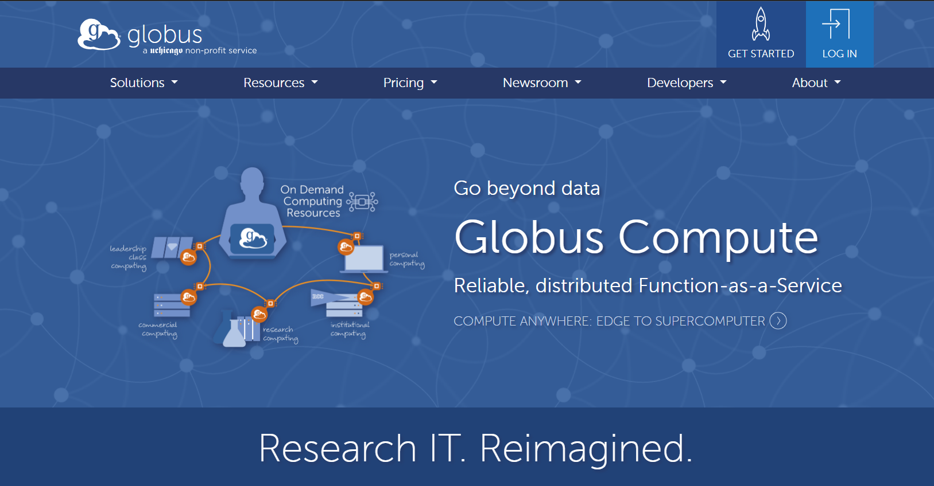
https://www.globus.org/

Slide 15
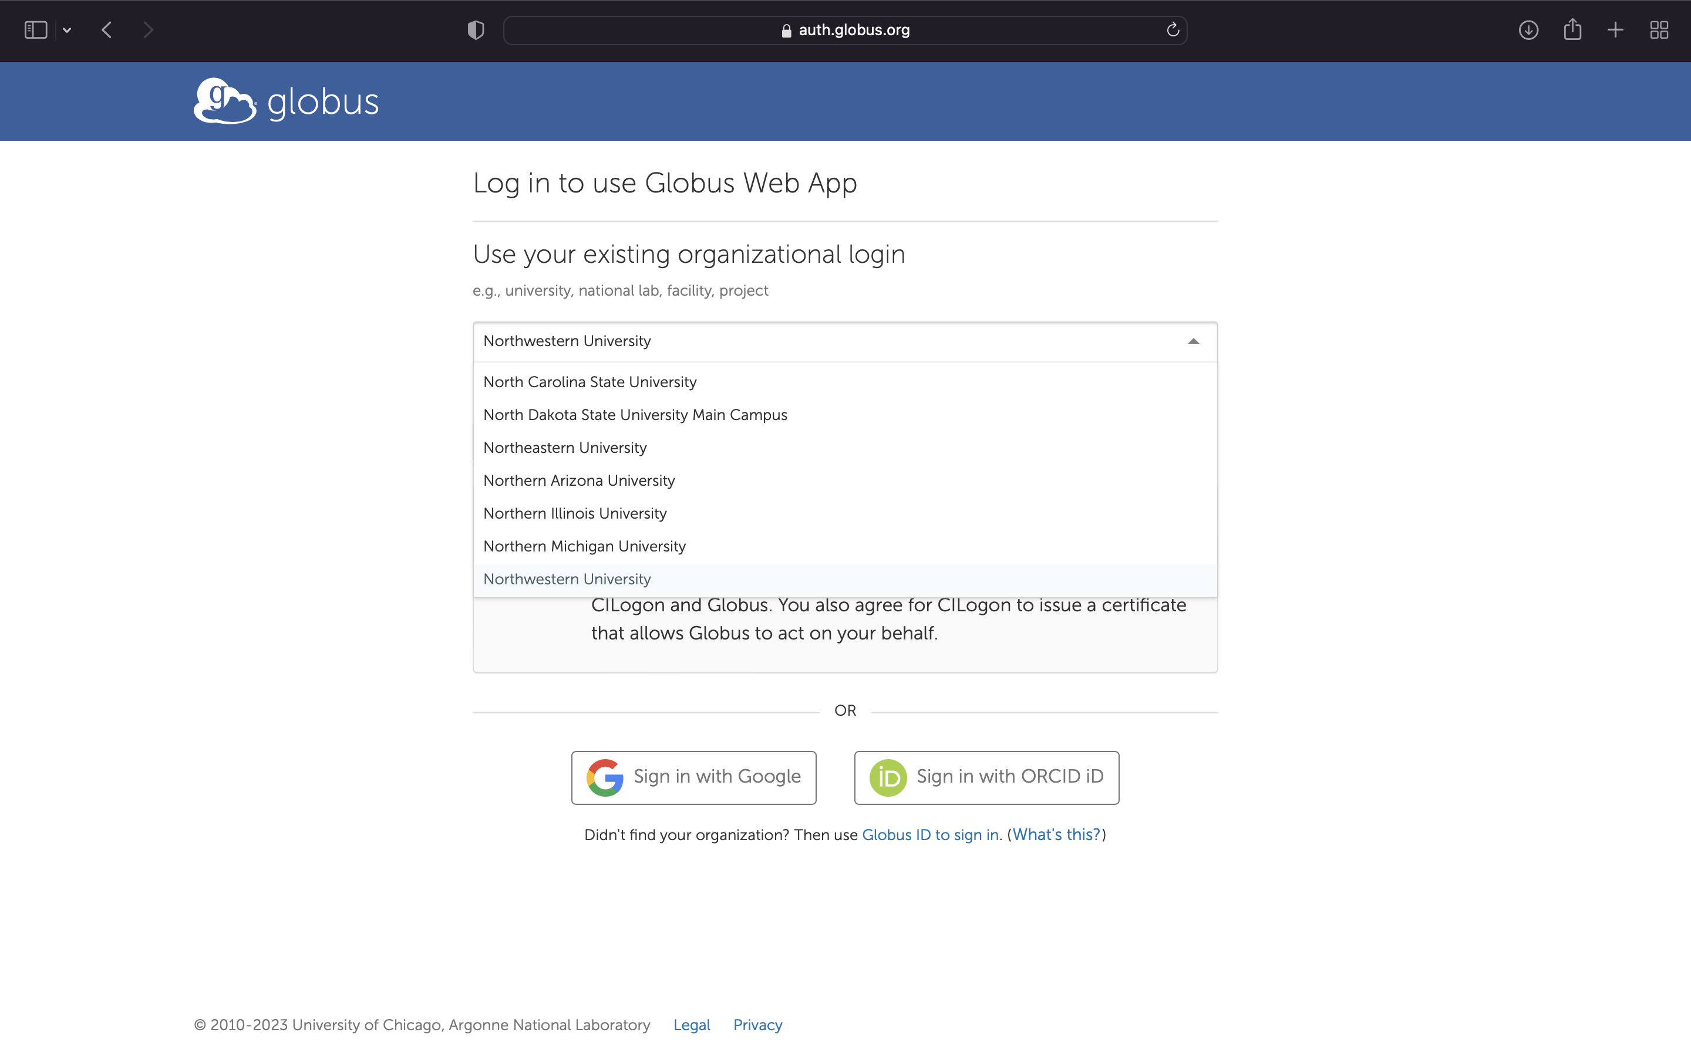
Logging in via NU Credentials

Slide 16
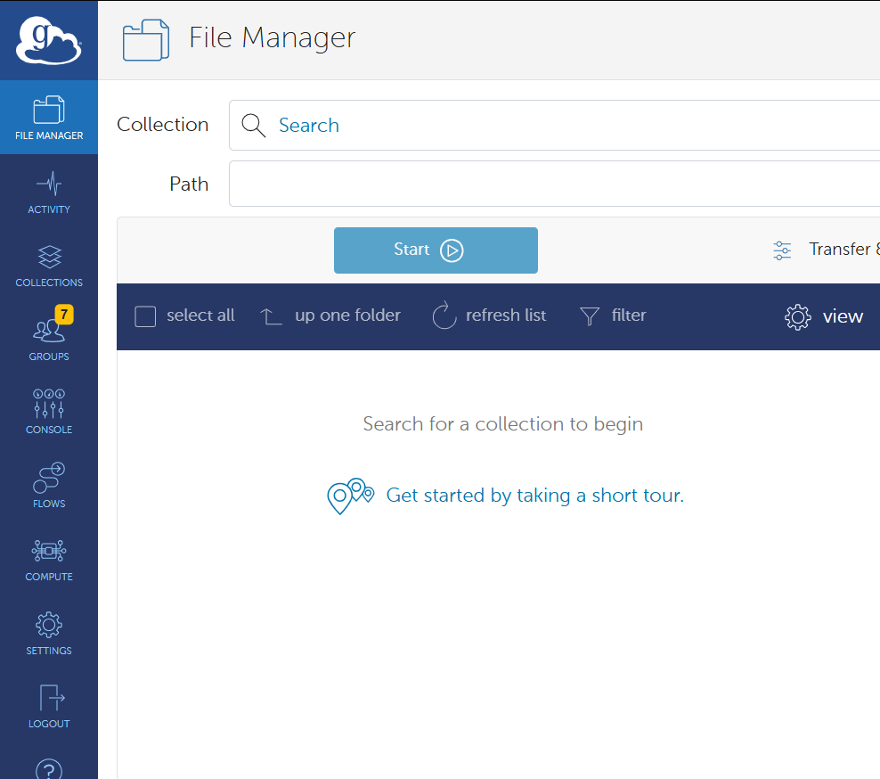
Registering an App: Developer Console

Slide 17
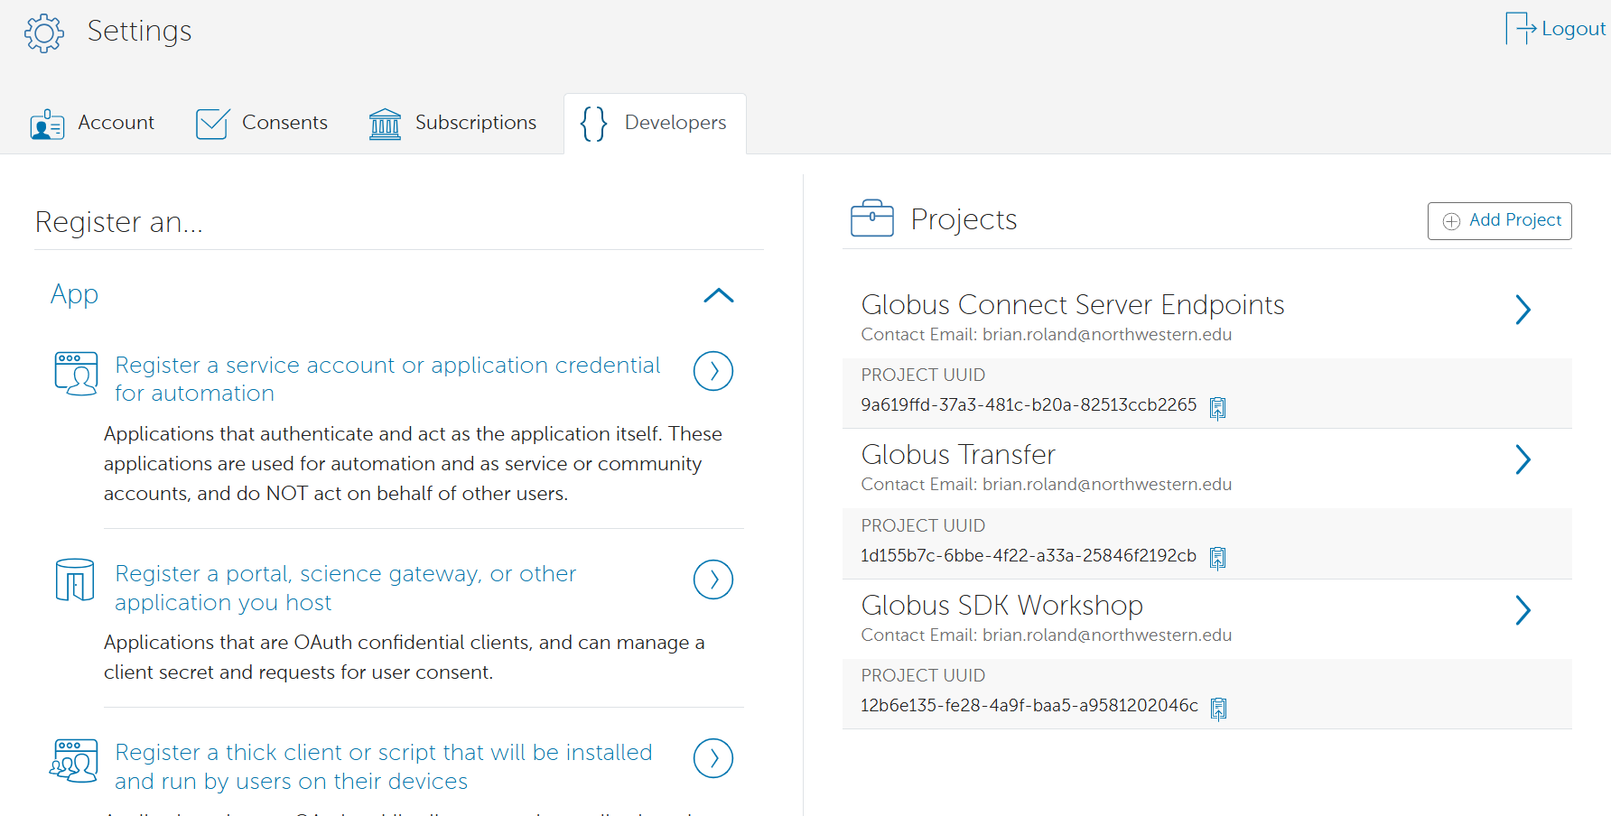
Registering an App: Developer Console

Slide 18
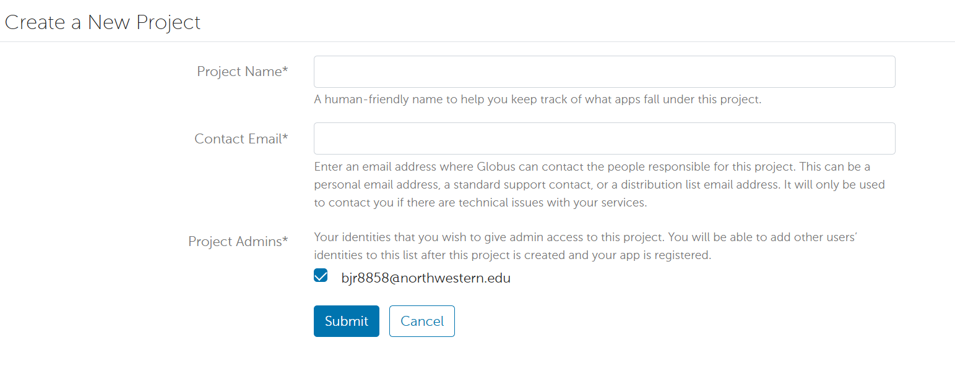
Registering an App: Create a New Project

Slide 19
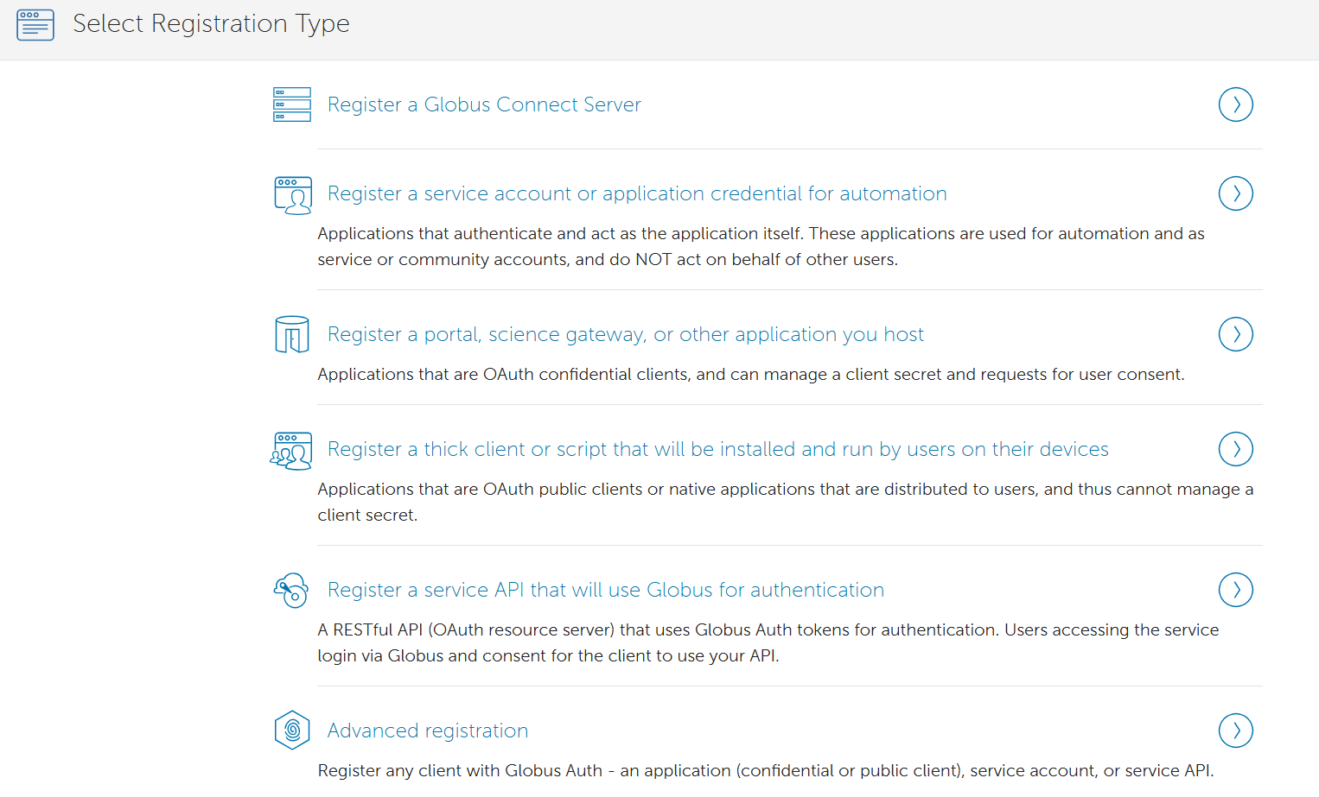
Registering an App: Add an App

Slide 20
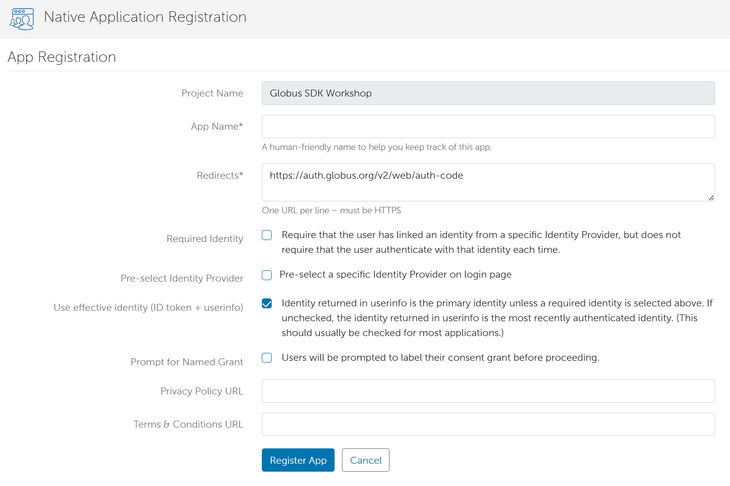
Registering an App: Native App

Slide 21
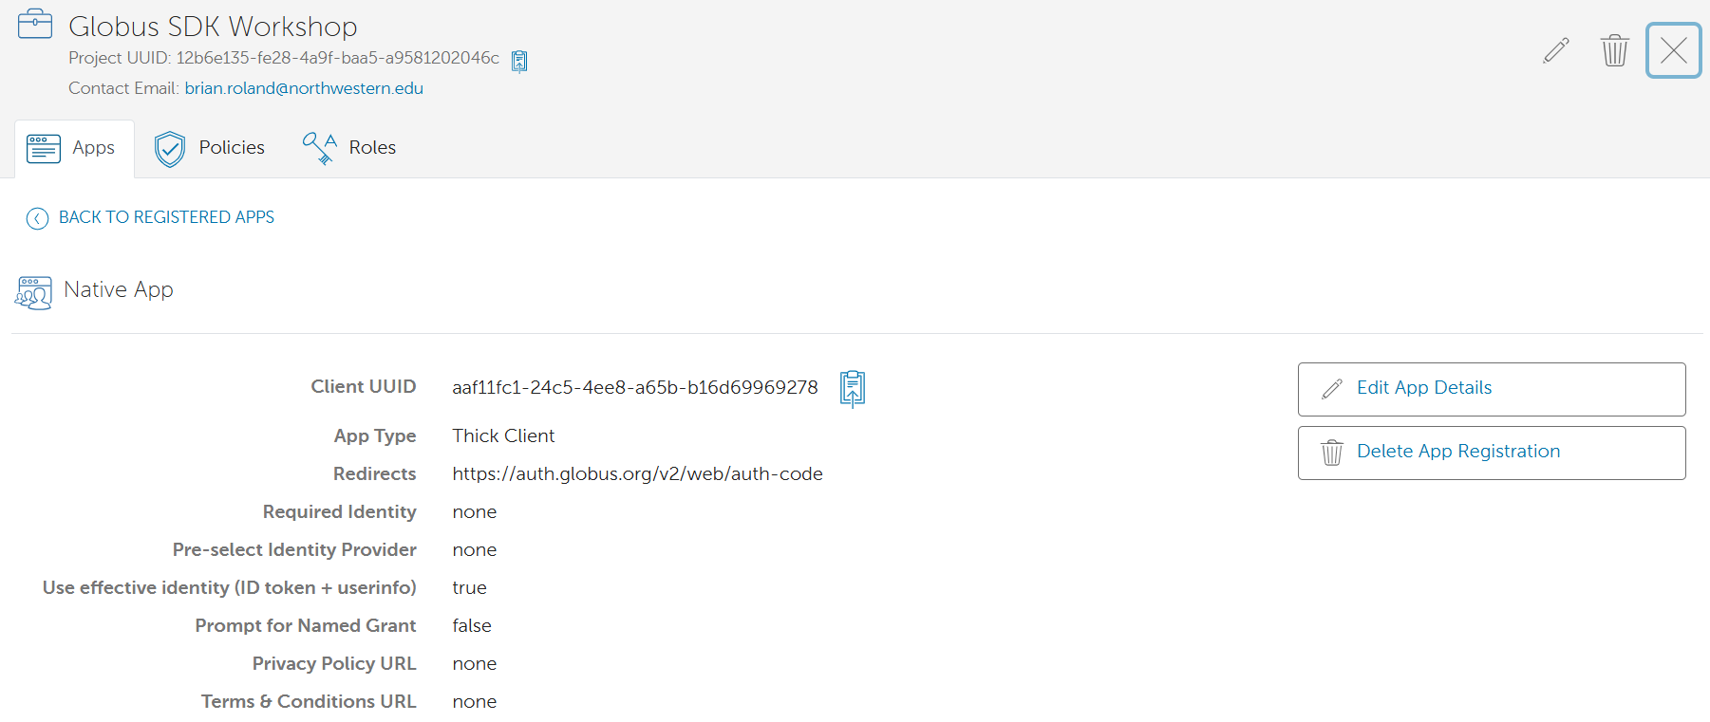
Registering an App: Native App

Slide 22
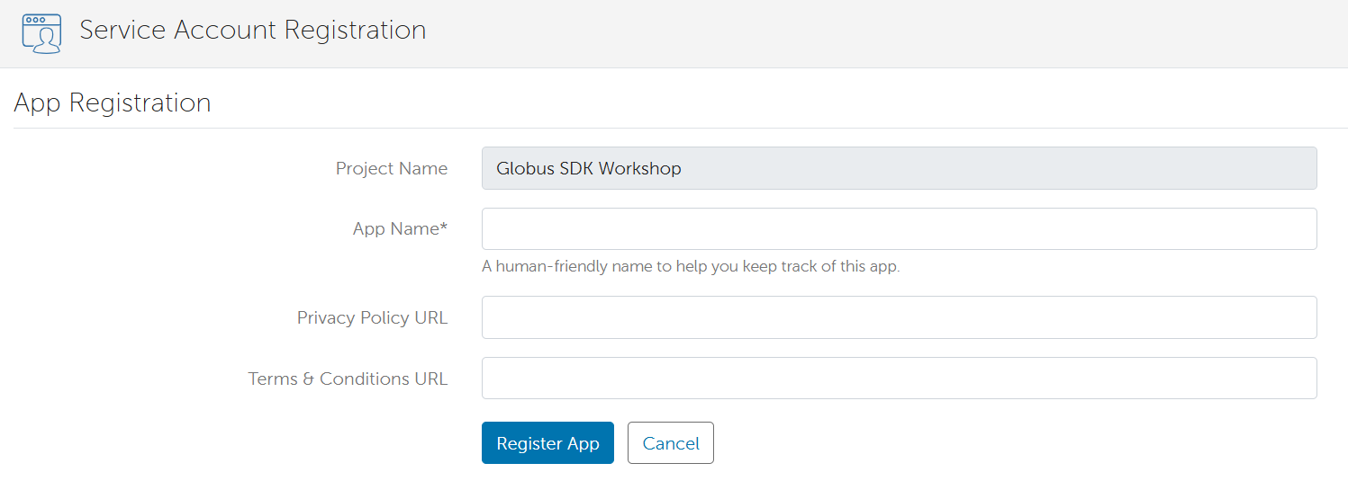
Registering an App: Service Account App

Slide 23
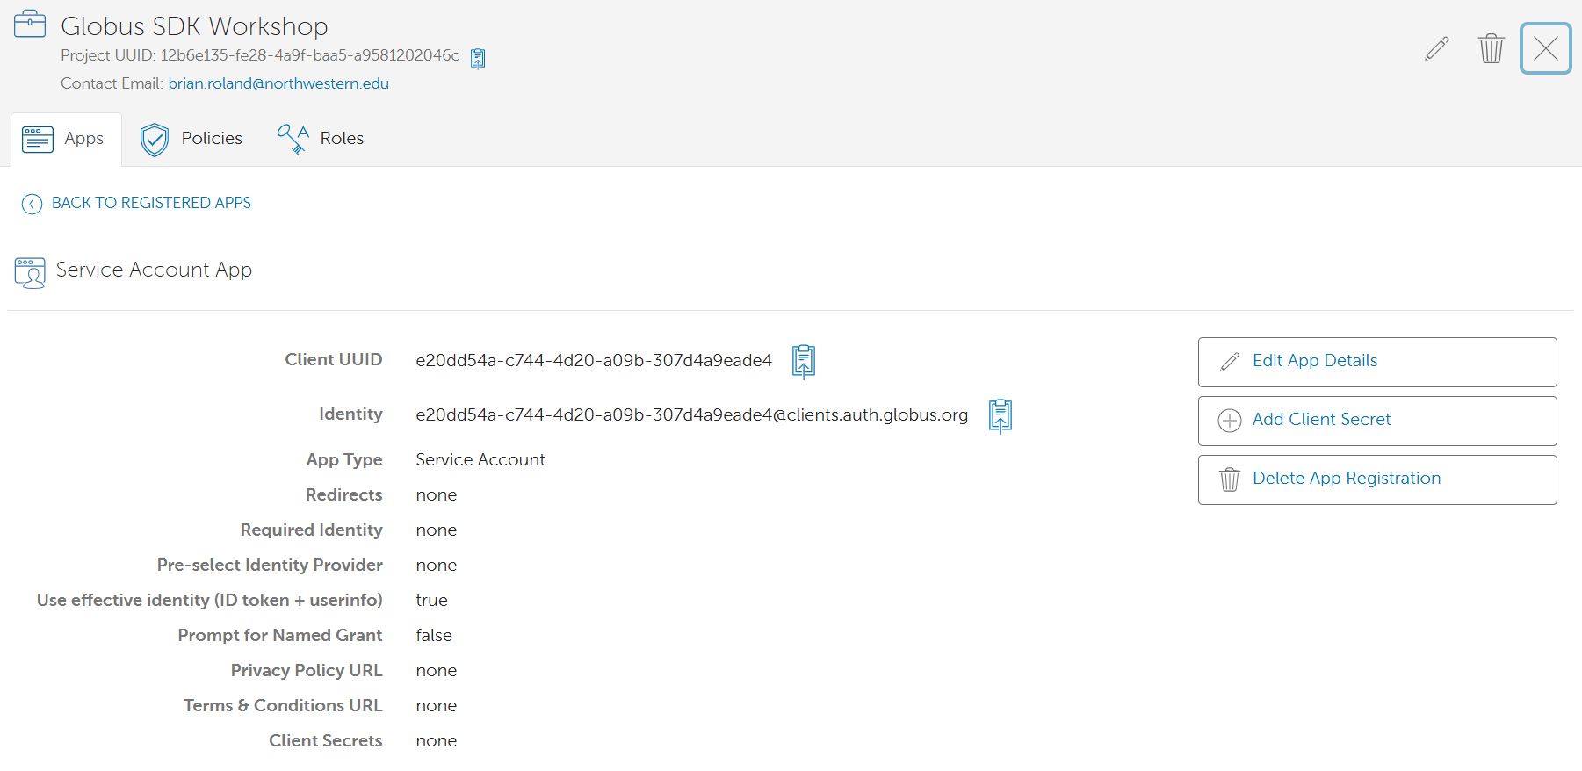
Registering an App: Service Account App

Slide 24
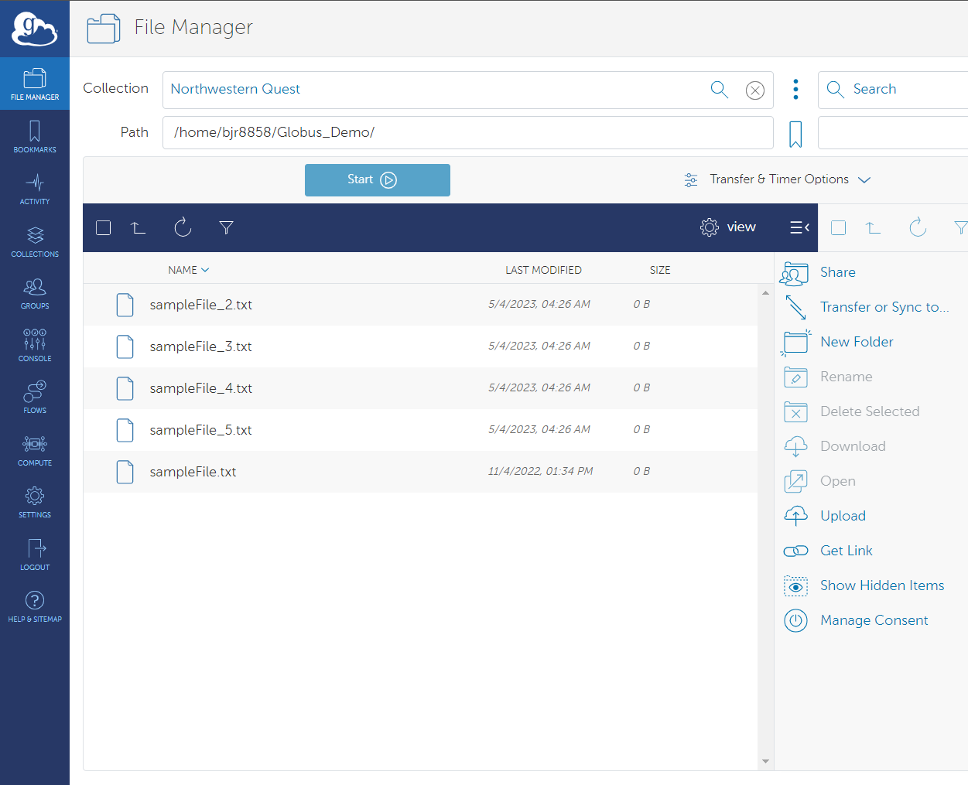
Create Guest Collection(s)
To setup a Guest Collection, navigate to the File Manager. In the Collection field, search for and select the Collection that the Guest Collection will be mapped to for access.
Once a Collection is selected and the Path is defined, the user should click on the Share link/icon to the right of the Collection
The Globus interface will next show a list of publicly listed Guest Collections. You will need to click on Add Guest Collection in the upper right-hand corner of the page

Slide 25
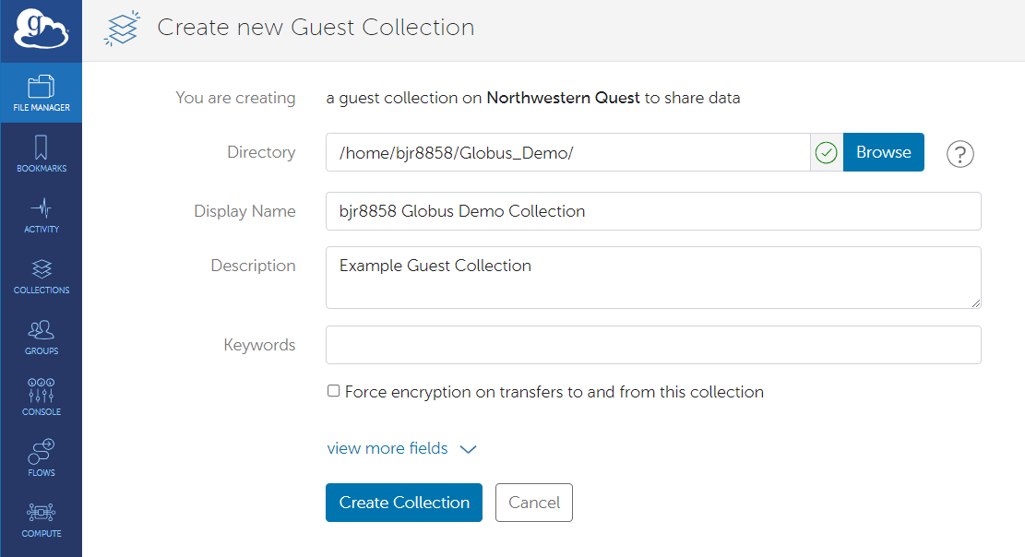
Setup Guest Collection
The user will then be asked to define the root directory for the Guest Collection. This will be the highest-level directory that collaborators will have access to.
The user is also required to enter a display name for the Guest Collection. This name does not need to be Globally unique, but a unique name is recommended
Once you have defined the Directory and Display Name for the Guest Collection, you will be able to then create the Guest Collection by clicking the Create Collection button
You will then be shown Permissions information on the Guest Collection that was just created. To share this Collection with collaborators the user would next need to click on Add Permissions – Share With

Slide 26
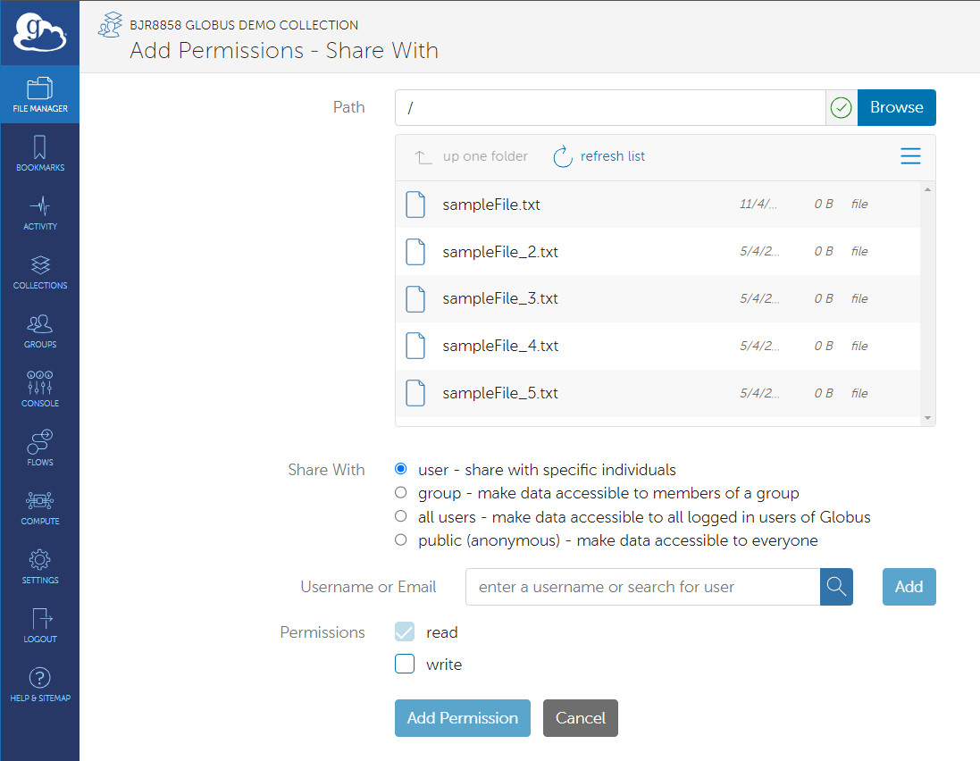
Data Sharing: Guest Collection Permissions
A new page will be displayed that will have a field to define the root on the Guest collection that external collaborators have access to. The interface will also display the files available in the path selected
Users will be able to select individual users or groups whom they want to share the path on the Guest Collection with.
Read and Write permissions can be assigned to the user or group that that should have access to the path indicated in the Path provided
By clicking Add Permission, users can add the user or group to having access

Slide 27
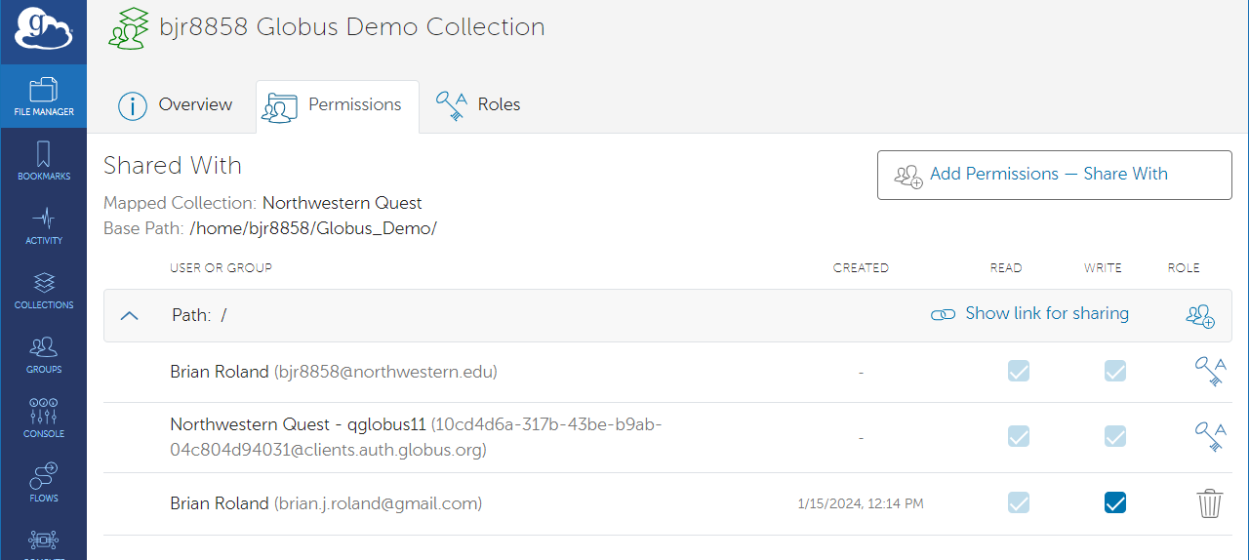
Data Sharing: Setup Guest Collection
Globus will return you to the Permissions page of the Guest Collection where it will list the users or groups who have access to the Guest Collection and the root path of each user’s access.
Return to the Overview page and take note of the UUID for the Guest Collection as that will be needed later in the Python code.

Slide 28
Key Steps in Using Globus SDK
Authentication
Token handling
Building a Transfer Task
  Source
  Destination
  Options
Submitting Transfer

Slide 29
Authentication with the Globus SDK
Globus uses OAuth2 for authentication, ensuring secure access to services.
In the Globus SDK, OAuth2 authentication is used to obtain tokens that allow applications to interact with Globus services programmatically.
The authentication process differs depending on whether the application is a Native App (requiring user authentication) or a Service Account App (operating as a service).

Slide 30
Authentication Flow for a Native App
The application requests authorization by opening a login URL in the user’s browser.
The user authenticates with their Globus identity and grants consent for the requested scopes.
The Globus Authorization Server returns an authorization code to the application.
The application exchanges the authorization code for an access token and a refresh token (if allowed).
The access token is used to make API requests to Globus services, while the refresh token allows the app to obtain new access tokens without requiring user interaction.

Slide 31
Authentication Flow for a Service Account App
The application requests an access token by sending its Client ID and Client Secret to the Globus Authorization Server.
The authorization server validates the credentials and issues an access token.
The access token is used to authenticate API requests on behalf of the application.
No user login is required unless specific user impersonation is needed.

Slide 32
What is a token?
Token:
  A token is a string of characters that serves as a means of authentication and authorization.
  Tokens are used to grant access to resources and perform actions within a system.
  They eliminate the need to repeatedly provide credentials.

Slide 33
Types of Tokens and Token Handling
Access Tokens: Short-lived tokens that authorize API requests.
Refresh Tokens: Long-lived tokens that allow the generation of new access tokens.
  Issued alongside the access token during initial authentication.
  When an access token expires, the refresh token is sent to the authorization server to obtain a new access token.
Securely store tokens to maintain authenticated sessions without requiring frequent logins.

Slide 34
Types of Tokens and Token Handling
Access Tokens: Short-lived tokens that authorize API requests.
Refresh Tokens: Long-lived tokens that allow the generation of new access tokens.
  Issued alongside the access token during initial authentication.
  When an access token expires, the refresh token is sent to the authorization server to obtain a new access token.
Securely store tokens to maintain authenticated sessions without requiring frequent logins.

Slide 35
Elements of Building a Transfer Task
To build a transfer task using the Globus SDK, you need to define:
Source Collection: The collection ID from which data is being transferred.
Source Path: The path to the file or directory on the source collection.
Destination Collection: The collection ID where data is being transferred to.
Destination Path: The corresponding file or directory path on the destination collection.
Transfer Options: Optional configurations to enhance the transfer process:
  Recursive Transfers: Enables transferring entire directories.
  Preserve Source file modification times: Ensures that the last modified date of a file at the destination matches the last modified date at the source
  Verify Checksum: Ensures data integrity by checking file checksums.
  Encryption: Encrypts data during transfer for security.
  Skip files on source with errors: Files on source with "file not found" and "permission denied" errors will be skipped rather than causing the entire transfer procedure to fail.

Slide 36
Globus SDK Live Demo
Authentication
Token Management
Build Transfer Task
Submit Transfer
Check Results

Slide 37
Live Demo: Use Case 1
A researcher in a materials science lab uses an electron microscope that generates large datasets. The data must be moved from the microscope’s local storage to the Quest high-performance computing (HPC) cluster for processing.
Globus Application Type: Native App
The researcher develops a Python script that automates data transfers using the Globus SDK.
Since the researcher runs this script interactively on their workstation, it is a native app that uses an OAuth2 authorization flow, requiring user login for authentication.
The script:
  Lists recent files from the instrument’s endpoint.
  Submits a transfer request to move the data to the HPC storage.
  Monitors the transfer for completion.

Slide 38
Live Demo: Use Case 2
A bioinformatics core facility uses a sequencer to collects genome sequencing data. As the data is generated, it must be automatically transferred to a centralized research storage system for long term data retention and analysis.
Globus Application Type: Service Account App
The researcher develops a Python script that automates data transfers using the Globus SDK without human intervention and must authenticate as a service.
Since the application needs long-lived access, it is registered as a confidential app using a client ID and client secret for authentication.
The script:
  Listens for new sequencing data files being written to the sequencer’s local storage.
  Authenticates using the confidential client credentials grant.
  Automatically transfers the data to centralized research storage.

Slide 39
References
Globus Doc
Globus CLI
Globus SDK
Globus github

Slide 40
Questions? globus-help@northwestern.edu

